Slide 1
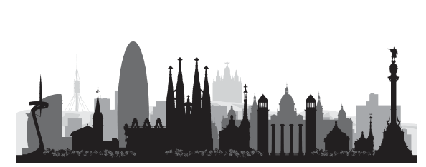

2024 revisions of the McDonald criteria
September 2024- ECTRIMS København
Xavier Montalban
An Initiative of the International Advisory Committee on Clinical Trials in MS

Slide 2
Disclaimer
Professor Montalban's institution has received compensation for lecture honoraria and travel expenses, participation in scientific meetings, clinical trial steering committee membership, or clinical advisory board participation in recent years from Abbvie, Actelion, Alexion, Bial PD, Biogen, Bristol-Myers Squibb/Celgene, EMD Serono, Genzyme, Hoffmann-La Roche, Immunic Therapeutics, Janssen Pharmaceuticals, Medday, Merck, Mylan, Nervgen, Neuraxpharm, Novartis, Peervoice, Samsung-Biosys, Sandoz, Sanofi-Genzyme, Teva Pharmaceutical, TG Therapeutics, Excemed, ECTRIMS, MSIF, and NMSS or any of their affiliates

Slide 3
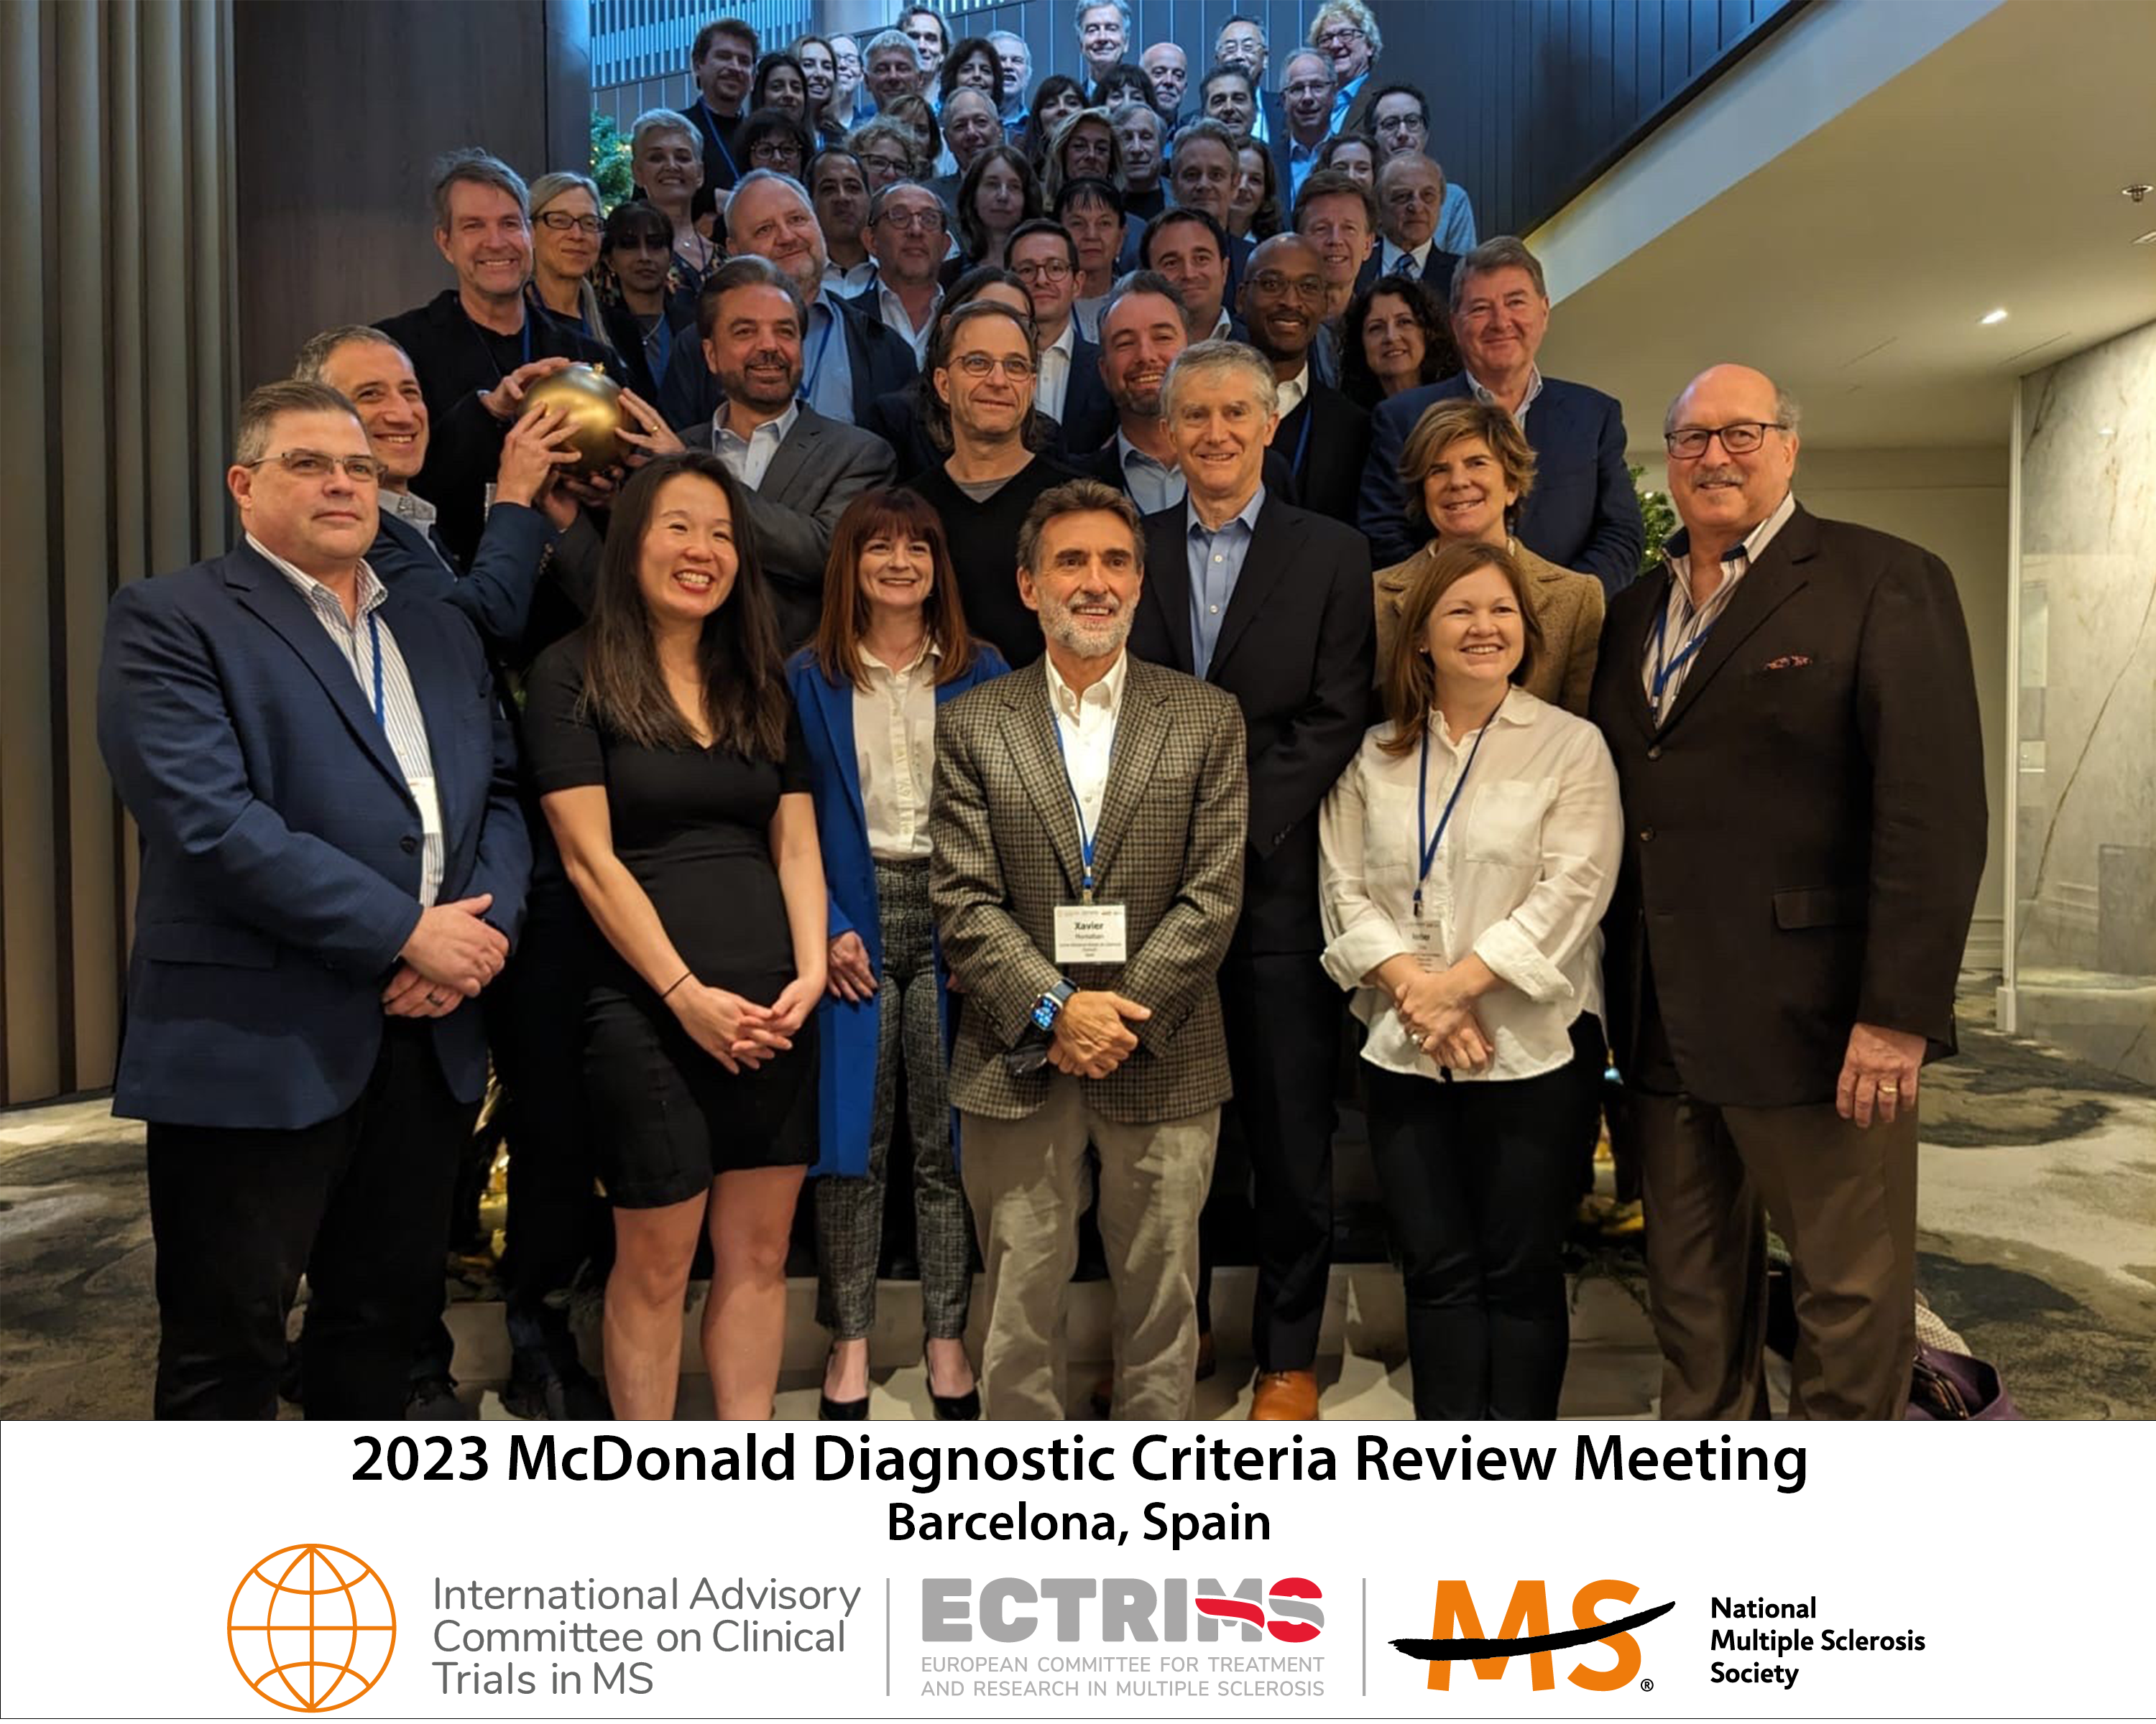



29 Nov-2 Dec 2023
Barcelona
Xavier Montalban, MD^{1,*}, Christine Lebrun-Frenay, MD², Jiwon Oh, MD³, Georgina Arrambide,MD¹, Marcello Moccia, MD^{4,5}, Maria Pia Amato, MD⁶, Lilyana Amezcua, MD⁷, Brenda Banwell, MD⁸, Amit Bar-Or, MD⁸, Frederik Barkhof, MD⁹, Helmut Butzkueven, MD¹⁰, , MD, Olga Ciccarelli, MD⁵, Jeffrey A. Cohen, MD¹¹, Giancarlo Comi, MD¹², Jorge Correale, MD¹³, Florian Deisenhammer, MD¹⁴, Massimo Filippi, MD¹⁵, Julie Fiol¹⁶, Mark Freedman, MD¹⁷, Kazuo Fujihara, MD¹⁸, Cristina Granziera, MD¹⁹, Ari Green, MD²⁰, Hans-Peter Hartung, MD²¹, Kerstin Hellwig, MD²², Ludwig Kappos, MD¹⁹, Dorlan Kimbrough, MD²³, Joep Killestein²⁴, MD, Fred Lublin, MD²⁵, Romain Marignier, MD²⁶, Ruth Ann Marrie, MD²⁷, Aaron Miller²⁵, MD, Susanna Otero, MD¹, Daniel Ontaneda, MD¹¹, Sudarshini Ramanathan, MD²⁶, Daniel Reich, MD²⁷, Mara Rocca, MD¹⁵, Alex Rovira, MD¹, Shiv Saidha, MD²⁸, Amber Salter, PhD²⁹, Jaume Sastre-Garriga, MD¹, Deanna Saylor, MD³⁰, Andy Solomon, MD³¹, Maria Pia Sormani, PhD³², Bruno Stankoff, MD³³, Mar Tintore, MD¹, Helen Tremlett, PhD³⁴, Anneke Van der Walt, MD⁹, Shanthi Viswanathan, MD³⁵, Heinz Wiendl, MD³⁶, Brigitte Wildemann, MD³⁷, Bassem Yamout, MD³⁸, Paola Zaratin, PhD³⁹, Peter Calabresi, MD²⁸, Timothy Coetzee, PhD¹⁶, Alan J. Thompson, MD⁵

Slide 4
Patient-Doctor dialogue¹
Treatment decisions²
Dx criteria impact on:
Clinical trials^{3,4}
Prognosis of MS²
¹DOI:10.1034/j.1600-0404.2003.00086.x
² DOI: 10.1212/WNL.0000000000012726
³ DOI: 10.1177/002203457705600303011
⁴ DOI: 10.1002/mus.27392

Slide 5
Convening Body
The international Advisory Committee on Clinical Trials in Multiple Sclerosis
The committee was responsible for production of all previous versions of the McDonald Criteria
Global panel MS experts sponsored by ECTRIMS and the National MS Society USA
Committee leadership
  Xavier Montalban, Chair
  Peter Calabresi, Vice Chair
  Ruth Ann Marrie, Past Chair

Slide 6
Timeline
Sponsors Approve
Revision Meeting
Preparatory Group
formed
2021
2022
2023
2024
Committee Leadership
Proposes revisiting 2017 criteria
Review Meeting
Barcelona, ES
Topical Reviews by
Full Clinical Trials Committee

Slide 7
2024 Revision Contributors
55 international experts with expertise clinical management, radiology, methodology, epidemiology, patient perspective
Included more first-time contributors to McDonald criteria
  17 Previous contributors
  38 New contributors
Global representation
  16 countries
  Africa, Asia, Europe, Middle East, LATAM, N. America, Oceania represented
  Included representatives from low resource settings
Gender Balance – 32 M/23 F

Slide 8
Consensus Methodology
Consensus recommendations were developed using a modified Nominal Group Technique
  Presentation of proposed revisions and supporting evidence
  Group discussion of proposals
  Presentation of general statements and recommendations
  Voting on statements and recommendations
Voting criteria
  90% of meeting participants vote must on a statement
  Statements and recommendations must receive 80% agreement to be accepted
  Statements receiving 70-80% may be reconsidered with an additional round of voting

Slide 9
2024 revisions of the McDonald criteria
General Principles for an MS Diagnosis
MS occurs throughout the world's populations, in all geographic regions, and race/ethnicities.
MS is an exclusion diagnosis (i.e. there is no better explanation).
Brain and spinal cord MRI remain the most useful paraclinical test to aid the diagnosis of multiple sclerosis.
An abnormal MRI showing typical lesions is required to make the diagnosis of multiple sclerosis
Misdiagnosis and underdiagnosis may have deleterious consequences for patients.
MS diagnosis should be reassessed periodically.
Statements applied to CIS may also applied to patients with a previous history of relapses without a diagnosis yet.

Slide 10
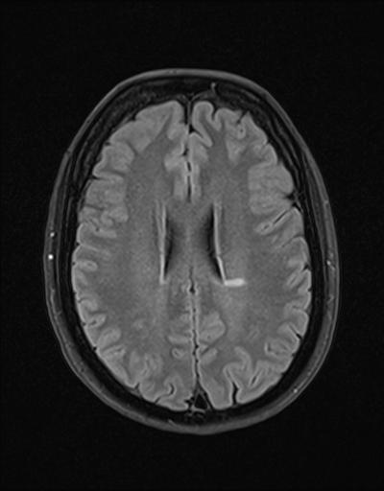
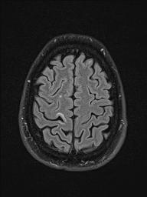
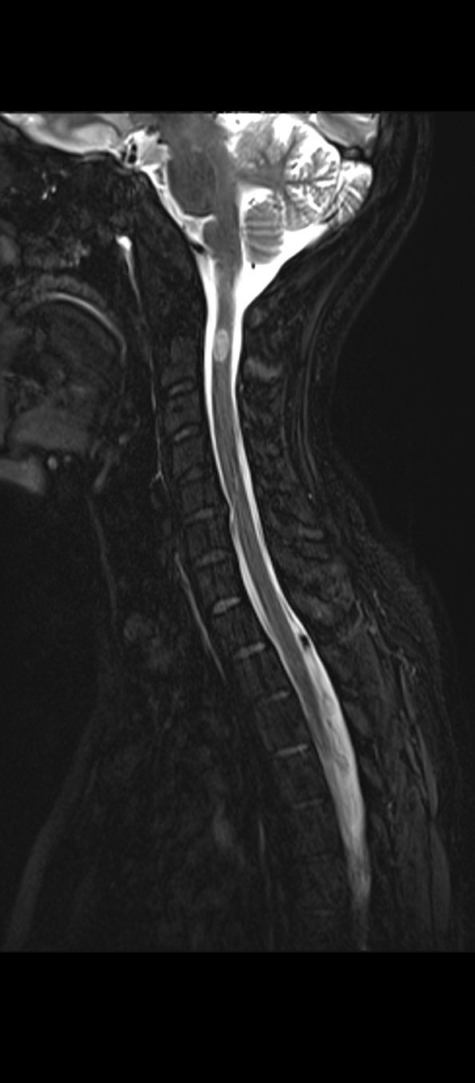
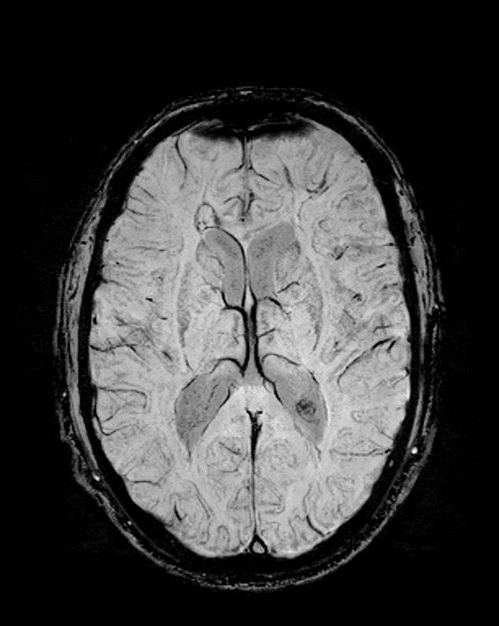
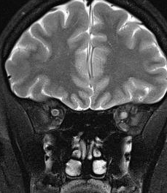
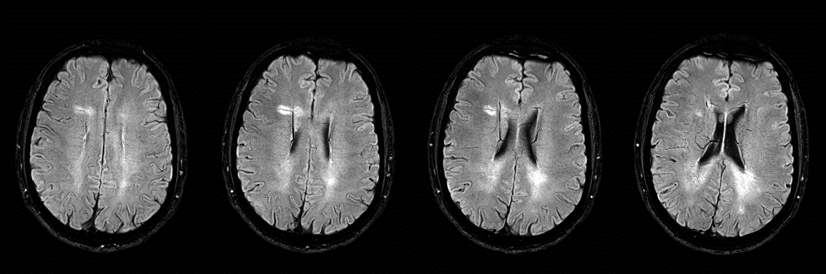
A
B
F
C
D
E
G
Courtesy by Àlex Rovira
Notes:
Figure 1
Characteristic topographies of multiple sclerosis lesions identified on T2-weighted images, including periventricular (A), leuko-cortical (B), optic nerve (C), infratentorial (D) and spinal cord lesions (E) (arrows). Novel MRI features identified on susceptibility-based images, including the paramagnetic rim lesion (F) and central vein sign (G) (arrows).

Slide 11
Proposed Revisions
RIS is MS in specific situations
Optic nerve as a fifth topography
DIT is not longer needed
Updated DIS criteria
kFLCs as a tool for diagnosis
Same criteria for PPMS and RMS diagnosis
Need of paraclinical evidence to diagnose MS
More strict features for confirming diagnosis in individuals over 50 years, or with headache disorders (including migraine), or with vascular disorders
Addition of CVS and PRLs as optional tools for diagnosis in certain situations
Laboratory tests (MOG-IgG Ab) for confirming diagnosis in children and adolescents

Slide 12
Proposed Revisions
Biological diagnosis
RIS is MS in specific situations
Optic nerve as a fifth topography
DIT is not longer needed
Updated DIS criteria
kFLCs as a tool for diagnosis
Same criteria for PPMS and RMS diagnosis
Need of paraclinical evidence to diagnose MS
More strict features for confirming diagnosis in individuals over 50 years, or with headache disorders (including migraine), or with vascular disorders
Addition of CVS and PRLs as optional tools for diagnosis in certain situations
Laboratory tests (MOG-IgG Ab) for confirming diagnosis in children and adolescents

Slide 13
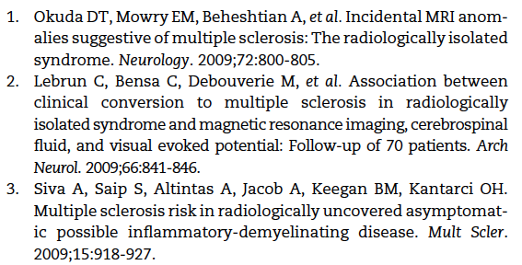
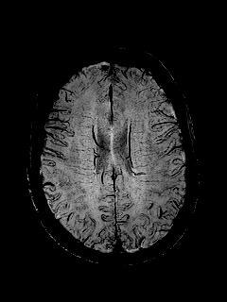
RIS
The radiologically isolated syndrome (RIS) is identified by the incidental discovery of CNS white matter T2-weighted hyperintense foci on MRI that demonstrate morphological and spatial characteristics highly typical of multiple sclerosis (MS) but without clinical symptomatology related to inflammatory demyelination¹⁻³

Slide 14

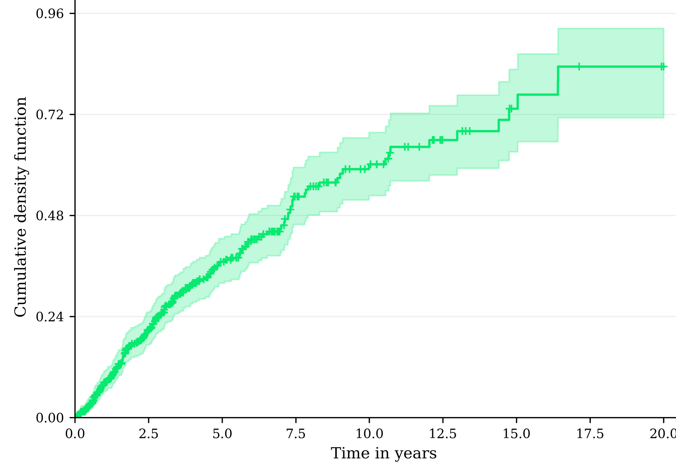
From RIS to clinical MS
15 years 72% (personal data)
10 years 51.2%
5 years 35%
The majority of patients will have MS at 10 years
2 years 19%
Lebrun et al 2020, 2021
Okuda et al, 2009, 2014
Kantarci et al, 2016
Christine Lebrun Frenay, International Advisory Committee on Clinical Trial in MS, Barcelona 2023

Slide 15
2024 revisions of the McDonald criteria
Radiologically Isolated Syndrome
General Principle
RIS is identified by the incidental discovery of CNS white matter T2-weighted hyperintense foci on MRI highly typical of MS but without clinical symptomatology related to inflammatory demyelination or findings on clinical examination.
Recommendations
In patients with RIS, fulfilling DIS and DIT is sufficient for diagnosing MS.
In patients with RIS, fulfilling DIS and OCB is sufficient for diagnosing MS.
In patients with RIS fulfilling DIS, the presence of ≥6 CVS is sufficient for diagnosing MS.

Slide 16
Proposed Revisions
RIS is MS in specific situations
Optic nerve as a fifth topography
DIT is not longer needed
Updated DIS criteria
kFLCs as a tool for diagnosis
Same criteria for PPMS and RMS diagnosis
Need of paraclinical evidence to diagnose MS
More strict features for confirming diagnosis in individuals over 50 years, or with headache disorders (including migraine), or with vascular disorders
Addition of CVS and PRLs as optional tools for diagnosis in certain situations
Laboratory tests (MOG-IgG Ab) for confirming diagnosis in children and adolescents
More easily and widely applicable

Slide 17
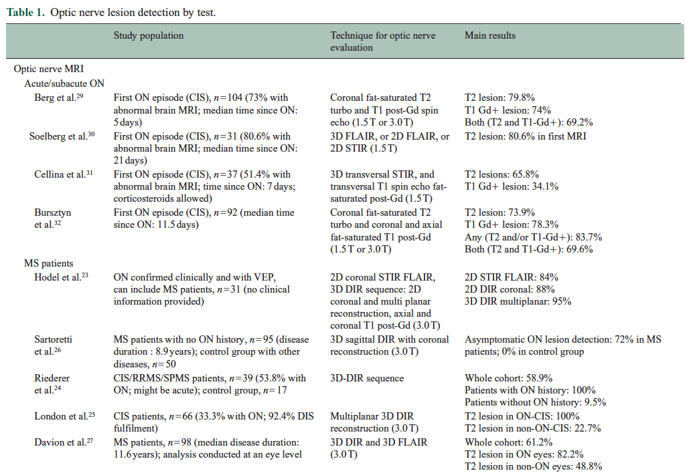
Optic nerve as a fifth topography
Optic neuritis represents the first manifestation of MS in 25-35% of CIS patients
Different rates of optic nerve involvement have been reported in established MS patients, based on the sequence used, and MS disease duration (ranging from 72.7% to 100% in eyes with prior history of ON, and from 8.8% to 72% in asymptomatic eyes)
Involvement of the optic nerve can be assesed by MRI, VEP and OCT
Considerable evidence supports the minimal threshold of at least one lesion in at least 2 out of the 5 topographies after including the optic nerve (Brownlee WJ et al. Neurology. 2018; Vidal-Jordana A et al. Neurology. 2021; Bsteh G et al. Neurology. 2023; Vidal-Jordana A et al. Neurology. 2024.
Vidal-Jordana et al. Mult Scler J 2024

Slide 18
2024 revisions of the McDonald criteria
Principles and recommendations regarding the visual system
General Principles and Recommendations
The optic nerve may serve as a fifth anatomical location to demonstrate DIS if no better explanation exists for optic nerve pathology.
One or more typical short segment intrinsic optic nerve lesions with no better explanation (including no prominent chiasmal involvement, perineuritis, or longitudinally extensive lesion) identified by MRI may serve as evidence of optic nerve involvement to demonstrate DIS
An abnormal peak time using a full field pattern reversal visual evoked potential (significant interocular asymmetry or p100 peak time above upper limit of normal with no better explanation) may serve as evidence of optic nerve involvement to demonstrate DIS.
An abnormal OCT (significant ppRNFL or GCIPL interocular thickness asymmetry, or ppRNFL or GCIPL thicknesses below lower limits of normal, with no better explanation) may serve as evidence of optic nerve involvement to demonstrate DIS.

Slide 19
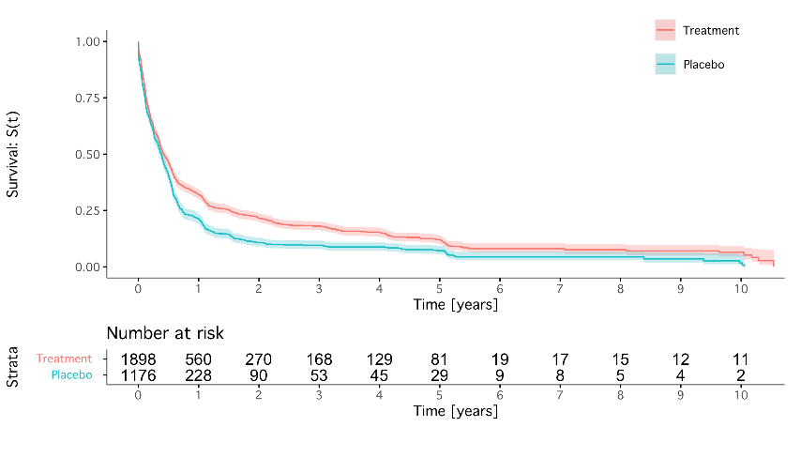
Demographical data and survival estimates to DIT
DIT is not longer needed and update DIS criteria
Characteristic | n
Sex, n (%) Female Male | 2,092 (68%) 987 (32%)
Age at CIS, years (SD) | 31.56 (7.88)
Baseline number of T2 lesions, n (%) > 8 1-3 4-8 | 2,242 (73%) 266 (8.7%) 545 (18%)
Presence of CSF-restricted OB, n (%)* | 290 (78%)
Baseline EDSS, median (IQR) | 1.50 (1.00, 2.00)
Last EDSS, median (IQR) | 1.50 (1.00, 2.00)
Follow-up years, median (IQR) | 2.66 (1.58, 5.05)
Dissemination in time, n (%) By CDMS By New T2 or Gd-enhancing lesions Combined | 1,080 (35%) 2,456 (80%) 2,586 (84%)
Dissemination in space⁋, n (%) At baseline† During follow-up‡ | 840 (77%) 494 (80%)
CIS TRIALS
BENEFIT (Bayer)
CHAMPS (Biogen)
TOPIC (Sanofi)
PreCISe (Teva)
REFLEX (Merck)
ORACLE MS (Merck)
Survival estimates for DIT Combined
(by arm)
* Partial information for BENEFIT study
⁋ Calculated for cerebral topographies (juxtacortical, periventricular and infratentorial)
† Calculated for BENEFIT and ORACLE MS studies
‡ Calculated for ORACLE MS study
Papolla A and Arrambide G et al. In preparation

Slide 20
2024 revisions of the McDonald criteria
CNS topographies in the MS Diagnosis –Dissemination in Space
General Principles and recommendations
DIS is fulfilled when 2 out of 5 topographies (ON, JC/IC, PV, IT, SC) show typical lesions, regardless of whether these lesions are symptomatic.
Fulfillment of DIS and DIT is sufficient to diagnose MS as stated in 2017 McDonald Criteria.
Fulfillment of DIS plus OCB and/or kFLC is sufficient to diagnose MS (No DIT needed) as stated in 2017 McDonald Criteria.
In patients with typical symptoms the presence of typical lesions in at least 4 topographies is sufficient to diagnose MS.
In patients with typical symptoms and typical lesions in one topography, the presence of 6CVS or PRLs plus DIT or CSF positive is sufficient to diagnose MS
In patients with progressive disease, two spinal cords lesions are enough to demonstrate DIS

Slide 21
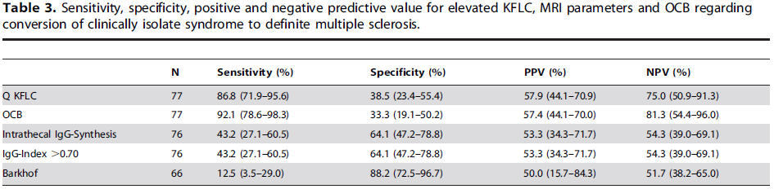
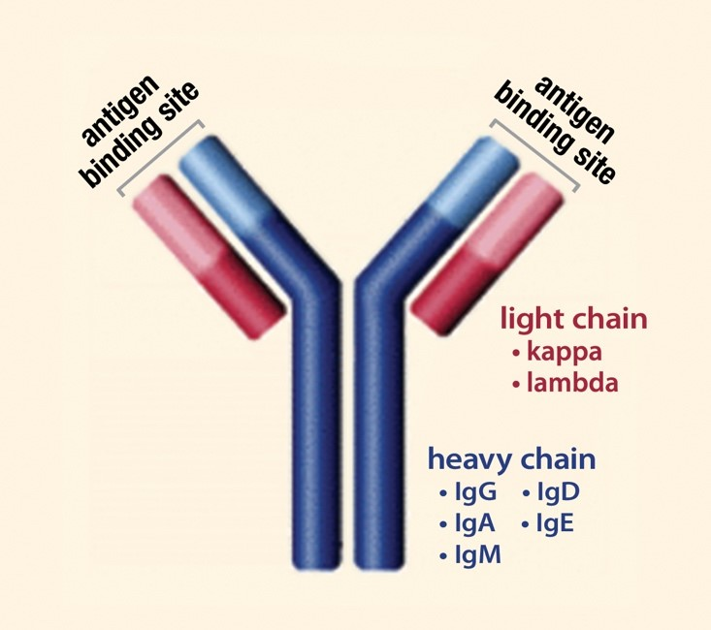
Kappa free light chains (KFLC) as a tool for diagnosis
Besides OB, an excess of kappa and lambda free light chains (KFLC, LFLC) can be produced during chronic intrathecal inflammation
They can be measured rapidly and quantitatively, and KFLC in particular have diagnostic properties that seem similar to those of OB in MS
KFLC differentiate CIS/MS from other neurological diseases/controls
The diagnostic properties of kFLC are also similar to those of OCB when assessed in CIS cohorts and, importantly, the concordance between OCB and kFLC is about 87.0%
KFLC could represent a valid, easier and rater-independent alternative to OB detection
An international panel of experts in CSF analysis recommended including intrathecal kFLC synthesis as an additional tool to diagnose MS besides OCB determination, after considering the pros and cons of each technique
Senel M et al. PLoS One. 2014, Presslauer S et al. Mult Scler. 2016, Passerini G et al. Mult Scler Int. 2016; Voortman MM et al. Mult Scler. 2017; Arrambide G et al. Brain 2018, Hegen H MSJ 2023

Slide 22
2024 revisions of the McDonald criteria
Kappa free light chains
General Principle
kFLC is an appropriate paraclinical test for the diagnosis of MS.
Recommendation
kFLC are interchangeable with OCB and consequently can substitute for OCBs for diagnosis of MS.

Slide 23
Proposed Revisions
RIS is MS in specific situations
Optic nerve as a fifth topography
DIT is not longer needed
Updated DIS criteria
kFLCs as a tool for diagnosis
Same criteria for PPMS and RMS diagnosis
Need of paraclinical evidence to diagnose MS
More strict features for confirming diagnosis in individuals over 50 years, or with headache disorders (including migraine), or with vascular disorders
Addition of CVS and PRLs as optional tools for diagnosis in certain situations
Laboratory tests (MOG-IgG Ab) for confirming diagnosis in children and adolescents
Increasing specificity
Papolla A and Arrambide G et al. In preparation
Papolla A and Arrambide G et al. In preparation

Slide 24
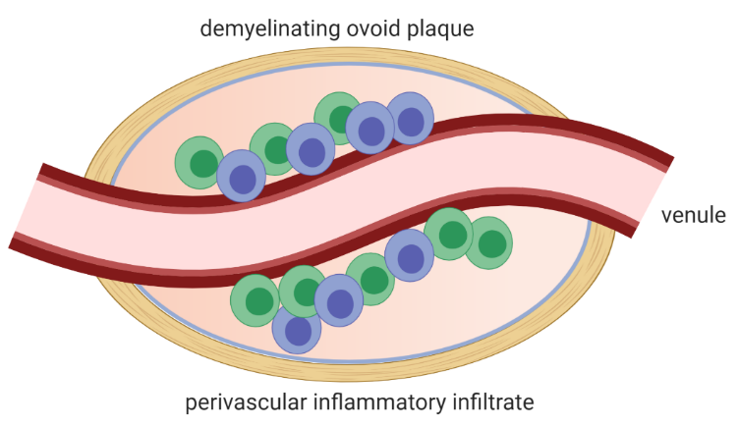
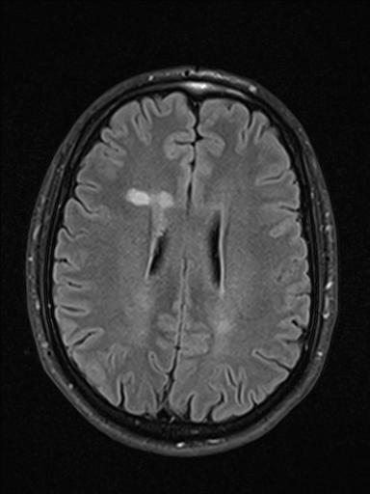
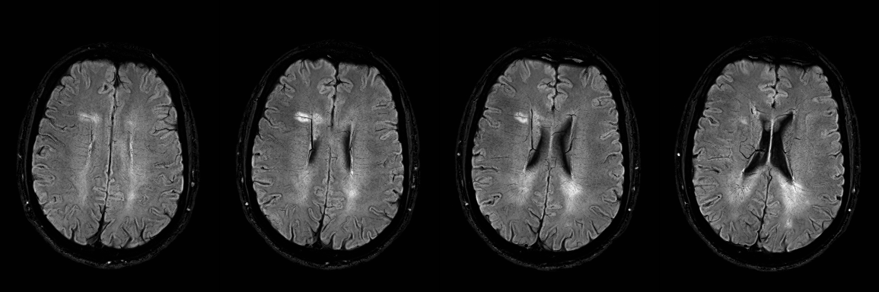
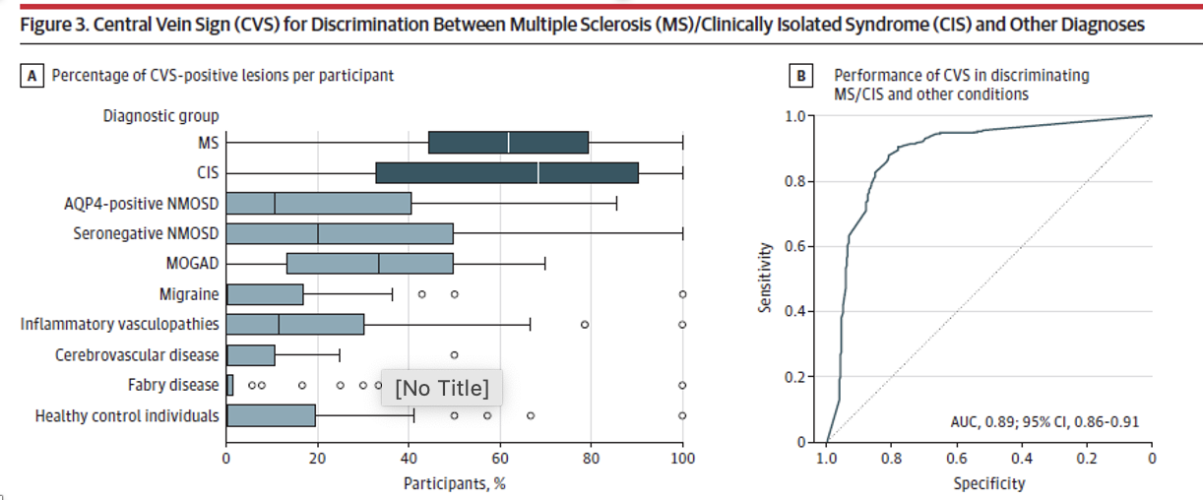
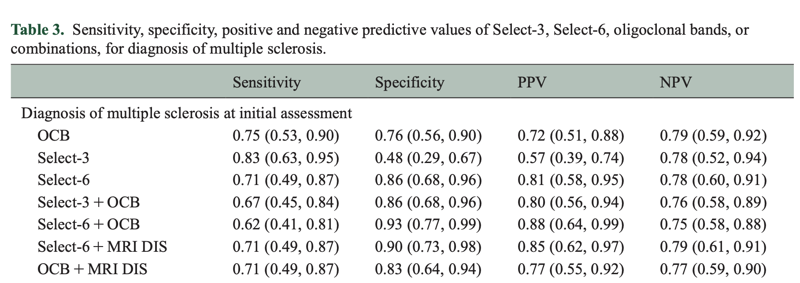
Ovoid shape: Dawson finger
Gill et al., Eur J Immunol 2023
NAIMS criteria
Sati et al. Nat Rev Neurol 2016
FLAIR
SWI (3T)
Thin hypointense line or small dot
Visualized in at least two perpendicular planes (and appears as a thin line in at least one plane)
Small apparent vein diameter (<2mm)
Runs partially/entirely through the lesion
Positioned centrally in the lesion
Central vein
Diagnostic performance
Dawson J. Trans Roy Soc Edinb 1916; Horowitz et al. Am J Neuroradiol 1989
NAIMS group: N=78, 10 sites, T2*EPI
Method | Sensitivity | Specificity
40% Threshold | 92% | 75%
50% Threshold | 89% | 80%
Select-3* | 81% | 64%
Select-6* | 65% | 93%
Ovoid shape lesion
(Dawson finger)
Cagol et al. JAMA Neurol 2024
Daboul et al. Mult Scler 2024
Toljan K et al. Mult Scler 2024

Slide 25
2024 revisions of the McDonald criteria
Central Vein Sign
General Principles and Recommendations
Demonstration of CVS by MRI may be used in the diagnosis of MS.
Demonstration of CVS by MRI can increase specificity of diagnosis in MS.
Demonstration of CVS is not required for diagnosis of MS.
In patients with typical symptoms and DIS the presence of rule of 6 CVS lesions is sufficient for diagnosis of MS.
In patients with typical symptoms and typical lesions in one topography, the presence of 6CVS plus DIT or CSF positive is sufficient to diagnose MS

Slide 26
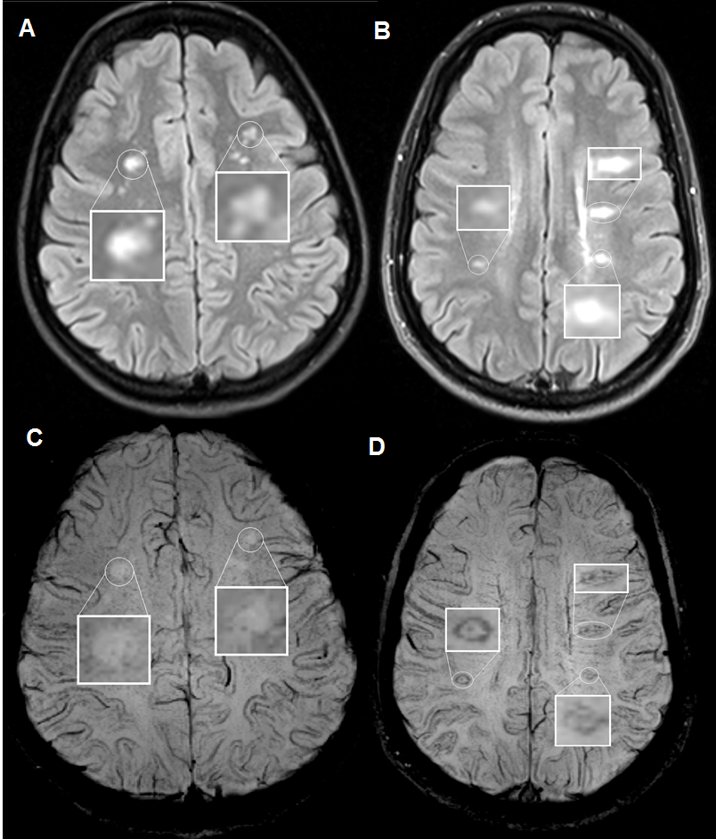
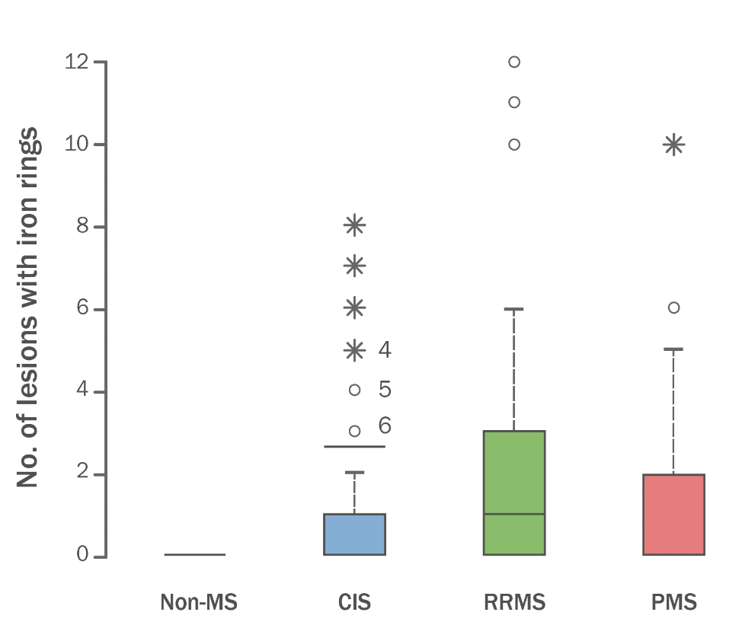
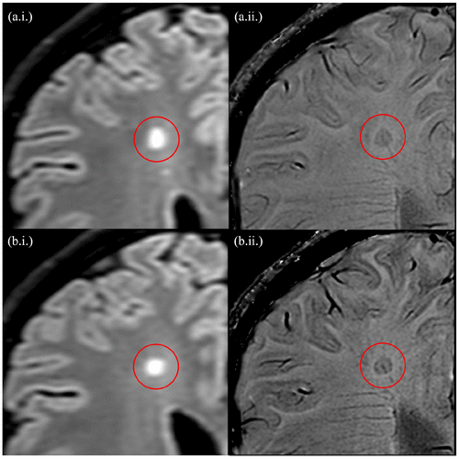
Paramagnetic rim lesions (PRLs): MS versus other CNS disorders
≥ 1 PRL in SWI has high specificity (99.7%)/low sensitivity (24%) when distinguishing MS/CIS vs mimics/healthy controls
(7 MAGNIMS Centers, 3T, various protocols, MS (n = 254), MS mimics (n = 91), older healthy controls (n = 217)
Systemic vasculitis
Multiple sclerosis
Iron
Microglia, Macrophages
Clarke MA et al. AJNR Am J Neuroradiol. 2020
48% of CIS, 59% of RRMS and 39% of PMS patients had at least one lesion with an iron rim**
Calvi et al. Mult Scler J 2020
Meaton I et al., Mult Scler. 2022

Slide 27
2024 revisions of the McDonald criteria
Paramagnetic Rim Lesions
General Principles and Recommendations
Demonstration of PRLs by MRI may be used in the diagnosis of MS.
Demonstration of PRLs by MRI can increase the specificity of diagnosis in MS.
Demonstration of PRLs is not required for diagnosis of MS.
In patients with typical symptoms and typical lesions in one topography, the presence of ≥1 PRL plus DIT or CSF positive is sufficient to diagnose MS

Slide 28
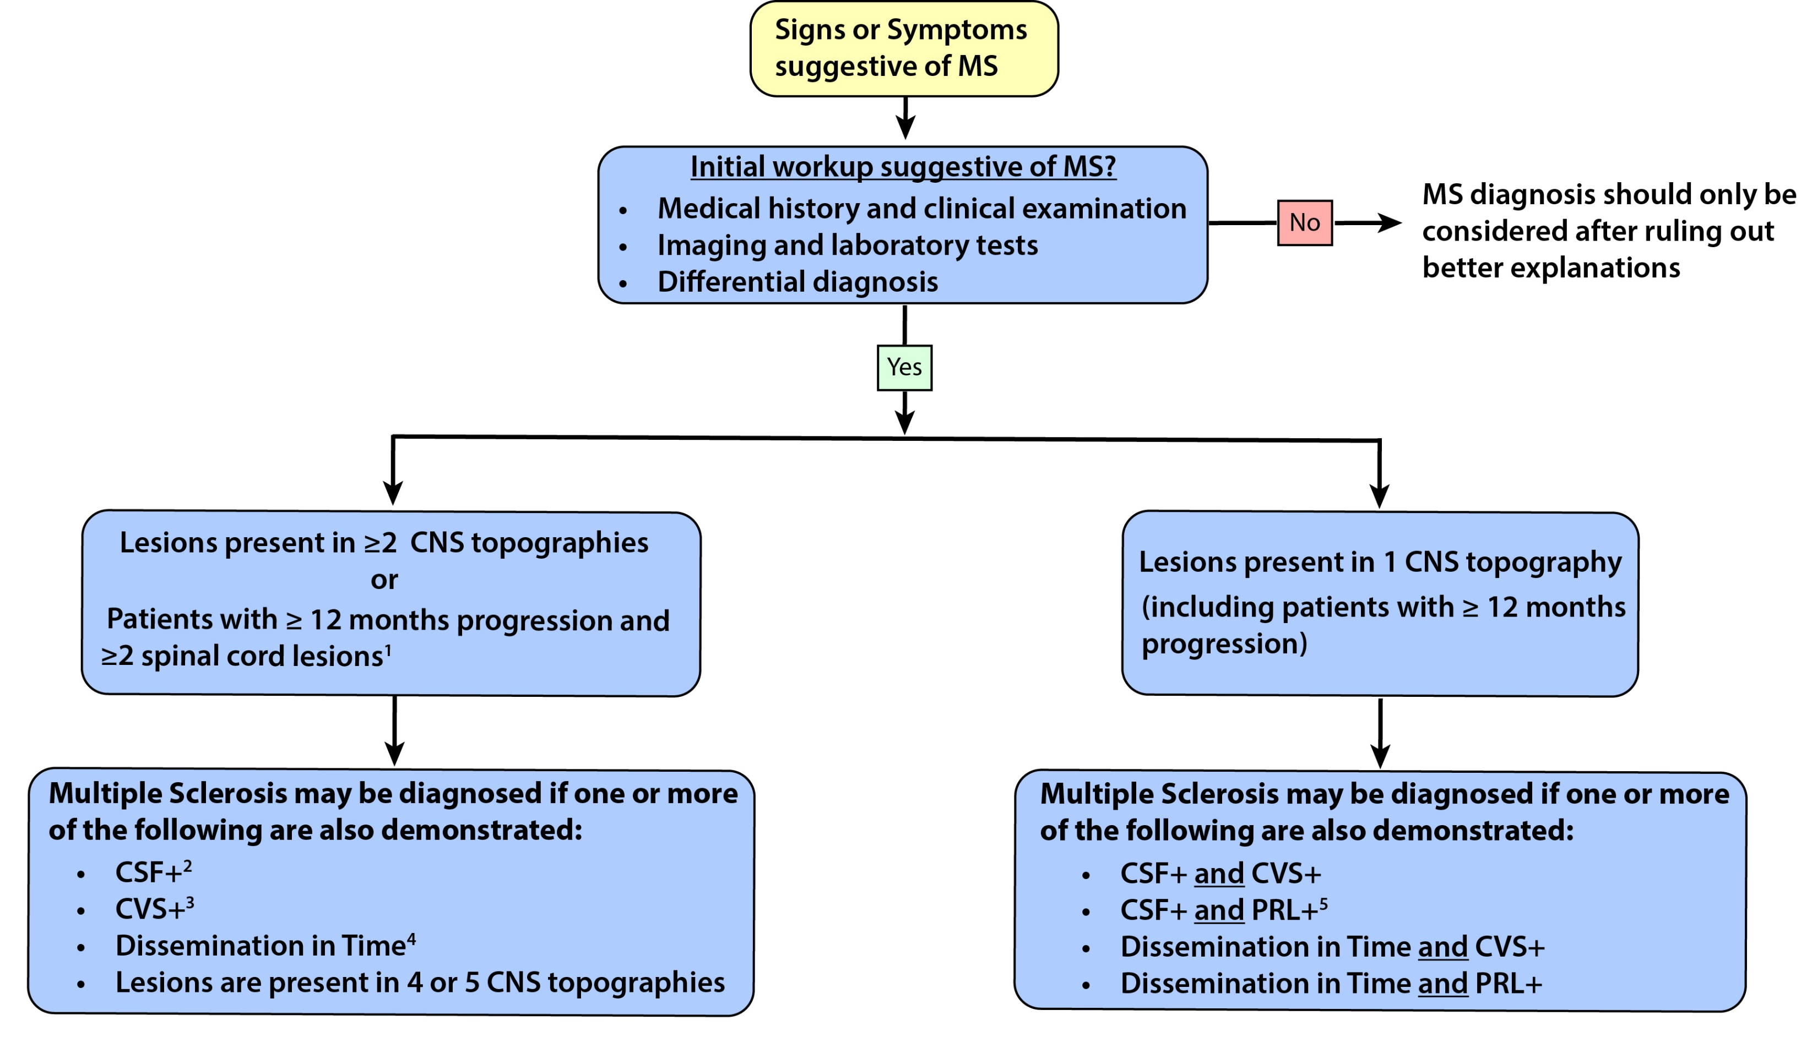

Slide 30
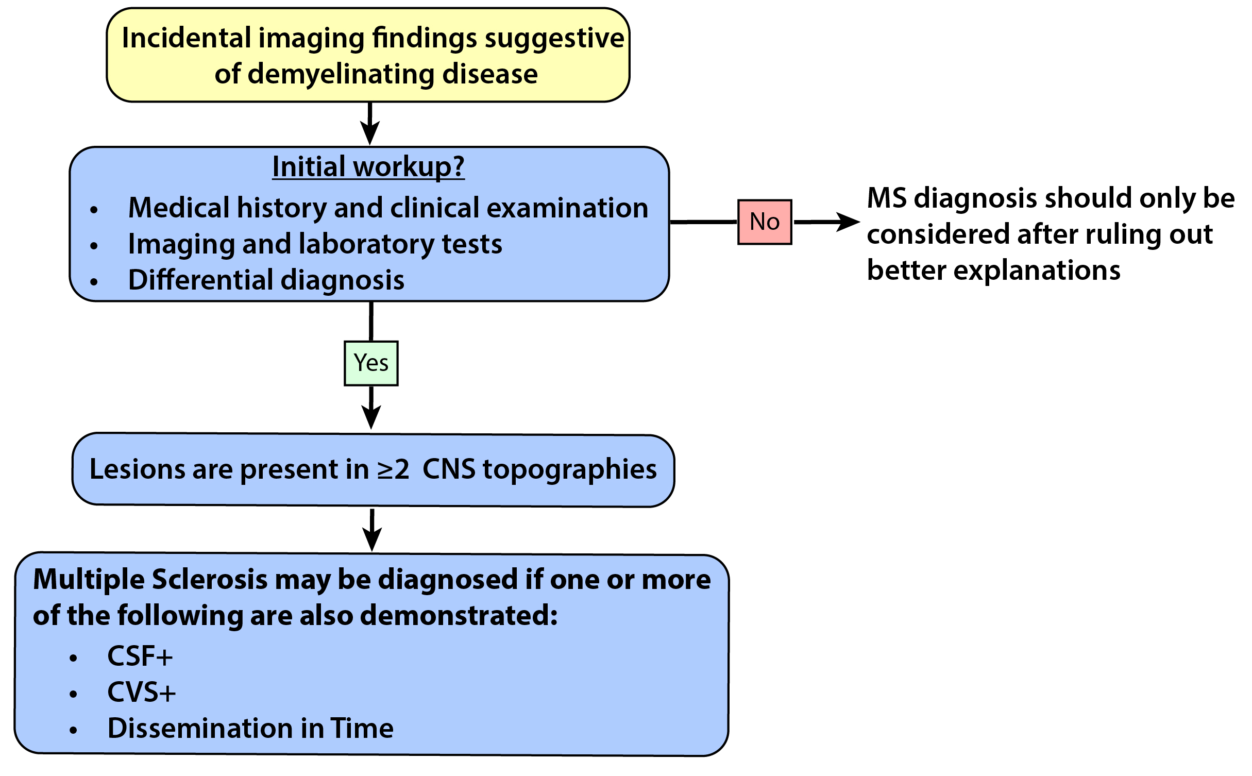

Slide 31
2024 revisions of the McDonald criteria
In patients who are being considered for a diagnosis of MS presenting at age ≥50 years and/or significant vascular risk factors (including hypertension, smoking, diabetes, hyperlipidemia) or known vascular disease and/or headache disorders, additional features are strongly recommended to confirm diagnosis of MS.
  A spinal cord lesion can serve as an additional feature.
  Positive CSF can serve as an additional feature.
  CVS select 6 can serve as an additional feature.

Slide 32
2024 revisions of the McDonald criteria
Pediatric MS
General Principles
Pediatric and adult-onset MS can be diagnosed using a single diagnostic criteria framework.
In patients with an ADEM presentation a second clinical attack consistent with typical MS attacks and/or new T2 lesions in typical MS topography >90 days post-ADEM onset, is required before the MS diagnostic criteria can be applied.
Recommendations
In children and adolescents (<18 years) the presence of CVS in approximately 50% of T2 lesions strongly suggests MS.
MOG-IgG testing using a cell-based assay is strongly recommended in children with an incident CNS demyelination under age 12 years.
In persons ages >=12 with an incident demyelinating event, MOG IgG testing using a cell-based assay is advocated in the context of an atypical presentation for MS but is not advocated for all persons being investigated for MS.

Slide 33
2024 revisions of the McDonald criteria
Primary Progressive MS
General Principles
PPMS requires evidence of clinical progression over at least 12 months
A single, unified framework of diagnostic criteria should be used to diagnose relapsing and primary progressive MS.
Recommendations
≥2 spinal cord lesions is evidence for DIS for a diagnosis of PPMS.

Slide 34
Open questions for future Revision
Demonstration of DIT using VEP and/or OCT
Refinement of the use of PRLs and CVS
Solitary sclerosis, and other atypical presentations
Performance of the criteria in diverse populations (e.g. Asia, LATAM region, etc.)
Use of other biomarkers as tools for diagnosis

Slide 35
Next Steps
Development of revised criteria paper and accompanying diagnostic algorithm
Consultation with wider MS community
Additional papers to be developed
  Implementation considerations (e.g. imaging, visual system, biomarkers, etc.)
  Global implications
  Patient considerations
Global education campaign

Slide 36
29 Nov-2 Dec 2023
Barcelona
Xavier Montalban, MD^{1,*}, Christine Lebrun-Frenay, MD², Jiwon Oh, MD³, Georgina Arrambide,MD¹, Marcello Moccia, MD^{4,5}, Maria Pia Amato, MD⁶, Lilyana Amezcua, MD⁷, Brenda Banwell, MD⁸, Amit Bar-Or, MD⁸, Frederik Barkhof, MD⁹, Helmut Butzkueven, MD¹⁰, , MD, Olga Ciccarelli, MD⁵, Jeffrey A. Cohen, MD¹¹, Giancarlo Comi, MD¹², Jorge Correale, MD¹³, Florian Deisenhammer, MD¹⁴, Massimo Filippi, MD¹⁵, Julie Fiol¹⁶, Mark Freedman, MD¹⁷, Kazuo Fujihara, MD¹⁸, Cristina Granziera, MD¹⁹, Ari Green, MD²⁰, Hans-Peter Hartung, MD²¹, Kerstin Hellwig, MD²², Ludwig Kappos, MD¹⁹, Dorlan Kimbrough, MD²³, Joep Killestein²⁴, MD, Fred Lublin, MD²⁵, Romain Marignier, MD²⁶, Ruth Ann Marrie, MD²⁷, Aaron Miller²⁵, MD, Susanna Otero, MD¹, Daniel Ontaneda, MD¹¹, Sudarshini Ramanathan, MD²⁶, Daniel Reich, MD²⁷, Mara Rocca, MD¹⁵, Alex Rovira, MD¹, Shiv Saidha, MD²⁸, Amber Salter, PhD²⁹, Jaume Sastre-Garriga, MD¹, Deanna Saylor, MD³⁰, Andy Solomon, MD³¹, Maria Pia Sormani, PhD³², Bruno Stankoff, MD³³, Mar Tintore, MD¹, Helen Tremlett, PhD³⁴, Anneke Van der Walt, MD⁹, Shanthi Viswanathan, MD³⁵, Heinz Wiendl, MD³⁶, Brigitte Wildemann, MD³⁷, Bassem Yamout, MD³⁸, Paola Zaratin, PhD³⁹, Peter Calabresi, MD²⁸, Timothy Coetzee, PhD¹⁶, Alan J. Thompson, MD⁵
2024 revisions of the McDonald criteria
September 2024- ECTRIMS København

